Slide 1

INTERNET TRAFFIC PREDICTION ON DATA SCIENCE
Project Supervisor: DR.S.GOWARI
Name of the Student: R AJAY DURGA SRIRAM
Register Number: 40120139

Slide 2
Presentation Outline
Course Certificate
Introduction
Objectives
Ideation diagram
Project implementation
Module implementations
Results and Discussions
Conclusion & Future work
References

Slide 3

Course Certificate

Slide 4
Introduction
The modern city is gradually developing into a smart city. The acceleration of urbanization and the rapid growth of urban population bring great pressure to urban traffic management. Intelligent Transportation System (ITS) is an indispensable part of smart city, and traffic prediction is an important component of ITS. Accurate traffic prediction is essential to many real-world applications. For example, traffic flow prediction can help city alleviate congestion; car-hailing demand prediction can prompt car-sharing companies pre-allocate cars to high demand regions. The growing available traffic related datasets provide us.

Slide 5
Why is traffic prediction important?
The accurate and effective prediction of the traffic flow of vehicles plays a significant role in the construction and planning of signalized road intersections. The application of artificially intelligent predictive models in the prediction of the performance of traffic flow has yielded positive results.
What is internet traffic prediction
Network Traffic Prediction (NTP) is a significant subfield of NTMA which is mainly focused on predicting the future of network load and its behavior. NTP techniques can generally be realized in two ways, that is, statistical- and Machine Learning (ML)-based.

Slide 6
Objectives
The web traffic is basically the number of sessions in given time frame, and it varies a lot with respect to what time of the day it is, what day of the week it is, and so on, and how much web traffic of platform can withstand depends on the size of the servers that are supporting the platform.
We will deep dive into the web traffic data set and look how can we use LSTM to solve the time series forecasting problem.

Slide 7
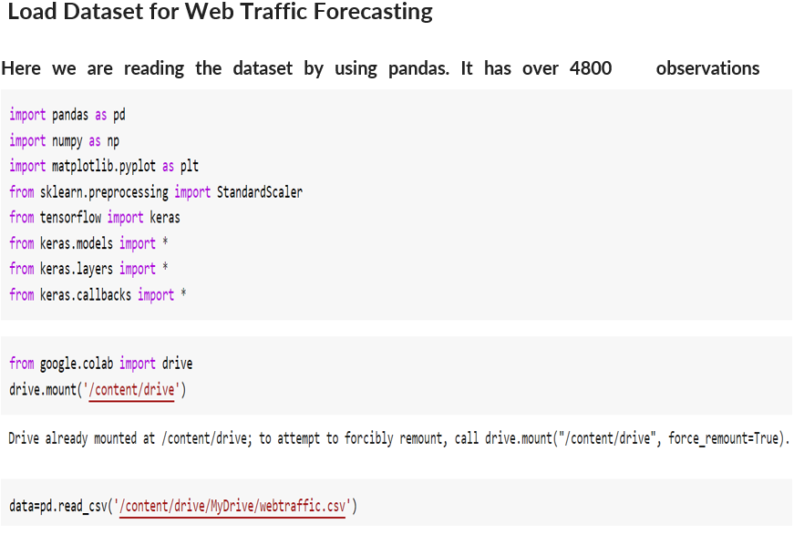

Slide 8
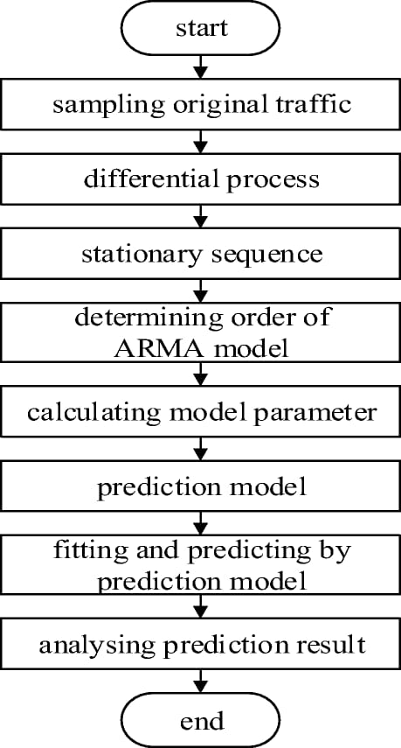
Pre-Position Diagram

Slide 9
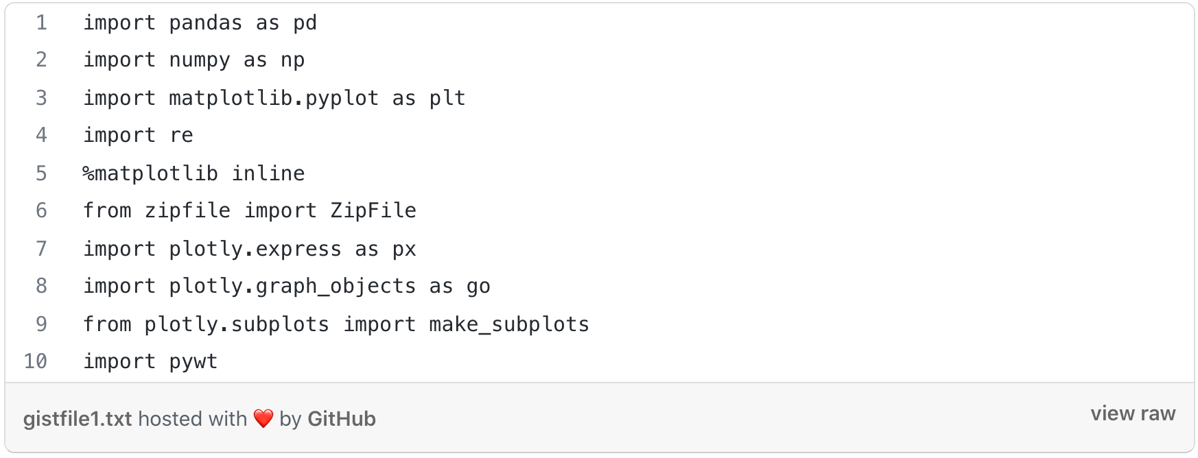
Module implementation 1.importing the libraries
Importing the libraries

Slide 10
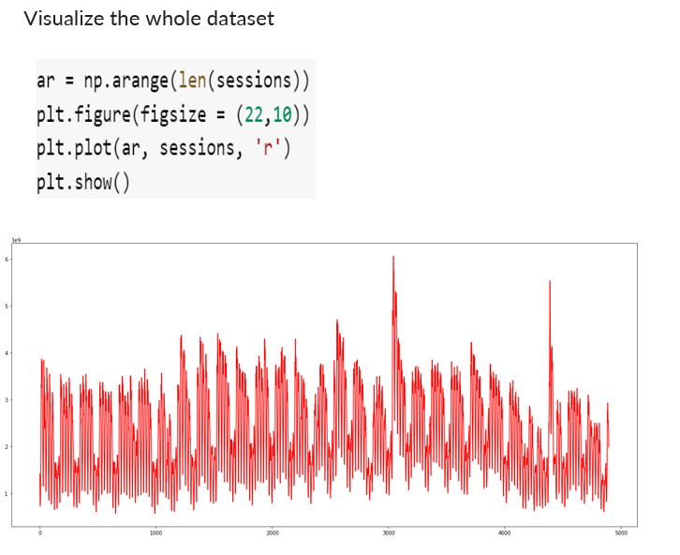
Application snapshots

Slide 11
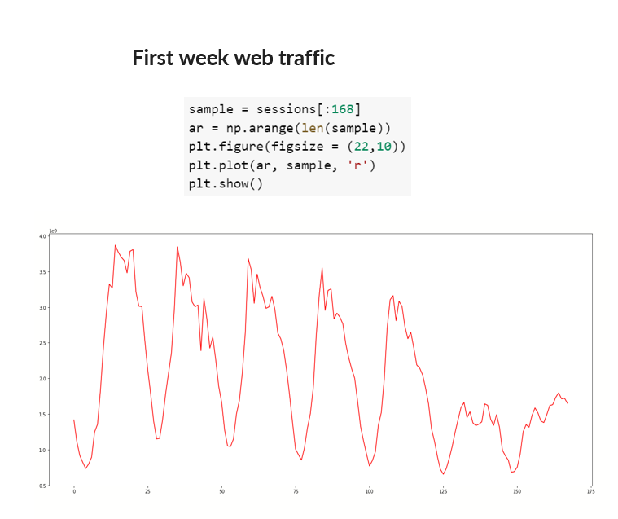

Slide 12
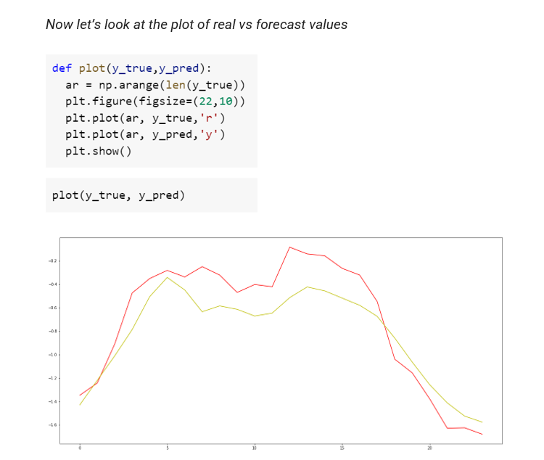

Slide 13
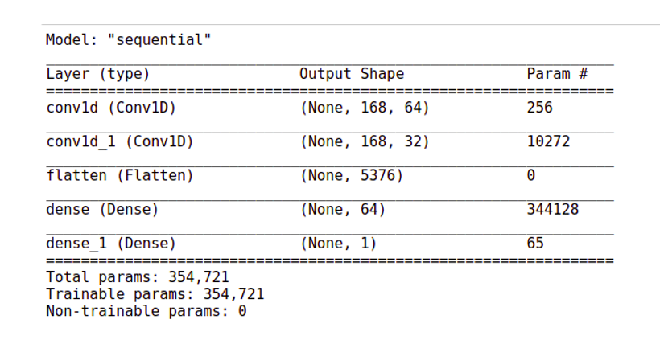

Slide 14
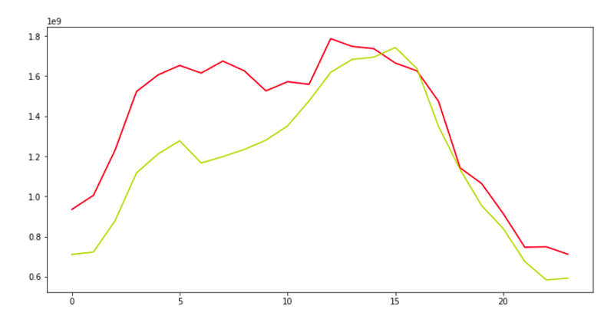

Slide 15
Results and Discussion
To identify the best topological structure of deep ANN for internet traffic prediction, the three different models of DBN were developed as discussed earlier. The performance measure of each deep ANN model is given in terms of Mean Square Error (MSE) and Root Mean Square Error (RMSE). All of the models achieve appreciable performance, but comparatively the first model produces more accurate predictions. This indicates that even for deeper architectures of ANN the proper selection of the number of hidden neurons on each layer is important, otherwise searching for the proper parameter space to initialize the network model may become difficult.

Slide 16
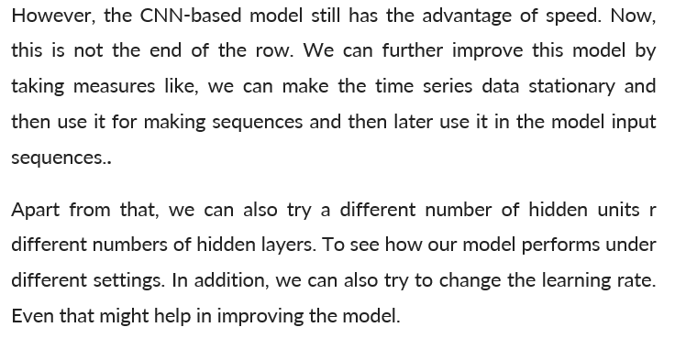
Conclusion

Slide 17
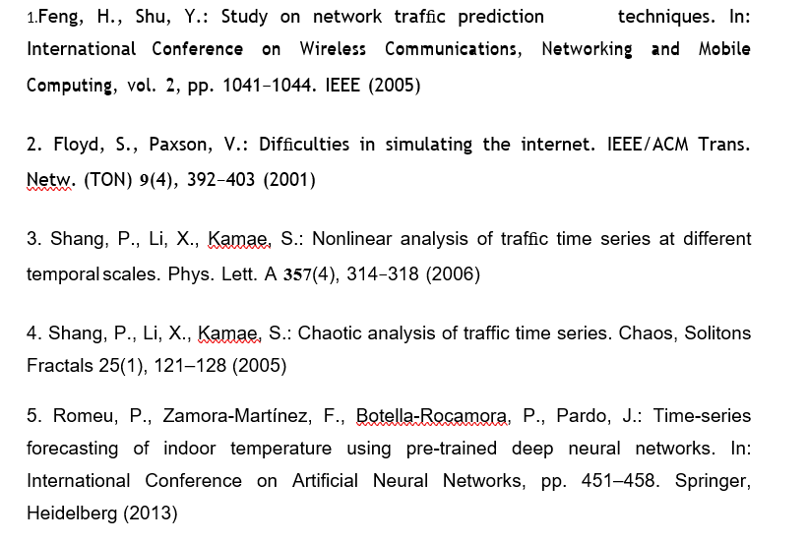
References

Slide 18
THANK YOU

